Slide 1
Update on IFX Pong
Youssef Tarkhan
21.08.2023

Slide 2
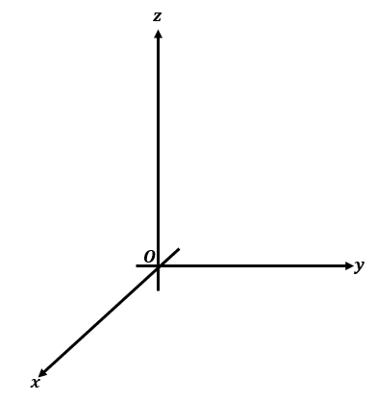
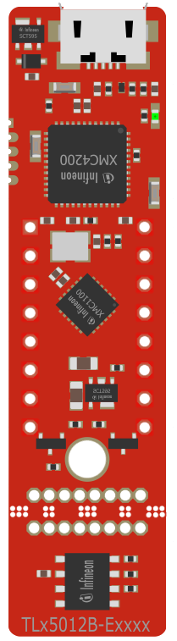

Current Setup
Controller Reading
Delta=Controller - Statation
Station Reading

Slide 3
Basic Python Game implemented
Station/Controller Dynamic is a lot more stable
Delta = Base – Controller
Delta drifts over time -> manual recalibration
Only needs some minor visual improvement, however mechanics do work
Player has to move up or down or else will bump into clouds
The more unbumped time (survival time) the higher the score

Slide 4

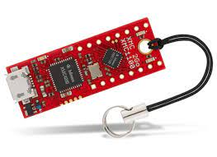
Next Setup
Controller Reading
Delta=Controller - Statation
Motion Up/Down
Motion Up/Down
GPIO
USB

Slide 5

Next Setup
Controller Reading
Delta=Controller - Statation
Motion Up/Down
GPIO

